Slide 1
Software Testing
Ali PARLAKÇI

Slide 2
Outline
Overview of testing
Flaky Tests
Introduction to Model-based Testing
SpecExplorer
GraphWalker
Industry’s views on model-based Testing
Introduction to Behavior-driven Development
SpecFlow for .NET

Slide 3
Testing is a crucial process
Tests shorten the development process in the long run.
Bugs are expensive.
Tests keep your code tidy.
Notes:
Hem bug’ları erkenden çözmek daha kolaydır, zamandan kaybınız daha azdır. Her dakika para kazandıran bir uygulamanın çalışmaması zarar demektir. Amazon’un birkaç saatliğine çalışmaması

Slide 4
To have reliable tests
Tests should cover 70% or more of the code base
Tests should be robust.
Tests should not get flakier as the product gets complex
Notes:
70% test kapsamı yakalamak ürün geliştikçe zorlaşır. Test etmeniz gereken çok fazla ihtimal var.
Test kodunun da en az ürünün kodu kadar kaliteli olması ve ince işçilikle yazılması gerekir. Çünkü testler projenizin planı gibidir. Bir problem olduğunda bu plana bakıp sorunlar çözülür.
Flaky test derministik olmayan testlere denir. Testler normalde aynı koşullarda aynı sonuçları vermelidir. Ancak flaky testler vermez. Spotify bunu yakalamak için özel araçlar geliştirdi.

Slide 5
Causes of flaky test
Assertion timing
Reliance on test order
Concurrency
Caching
Setup & Cleanup

Slide 6
Real life example
Notes:
Test yazmak basit konu değil. Zeka istiyor.

Slide 7
Model-based Testing

Slide 8
How cavemen used to test their software
Develop the System (Program to be tested)
manually give inputs to system
and expect outputs
Reports

Slide 9
Industry’s way of testing
Develop the System
pre-defined test inputs
and expected outputs
concrete test case
run through an automation software
Reports
Notes:
Ask what the problem might be in this paradigm.

Slide 10
MBT’s approach of solving those issues
Develop the System
Concrete, runnable test cases
run through an
automation software
Reports
map test cases to
actual statements
or method calls
Describe
the System Under Test
(Make a model)
auto-generated test inputs
and expected outputs
Abstract test cases

Slide 11
How does MBT helps?
Only maintain the model instead of every test case.
Model expands as new features are added.
Test cases are now randomized.

Slide 12
Applications of MBT

Slide 13
Applications of Model-based Testing
SpecExplorer for Visual Studio
Models as C# classes.
Runnable test cases as C# classes.
Discontinued 10 years ago and replaced by IntelliTest for Visual Studio Enterprise Edition.

Slide 14
Demo

Slide 15
Applications of Model-based Testing
GraphWalker
Models as diagrams
Controls test process via HTTP
No runnable concrete test cases.

Slide 16
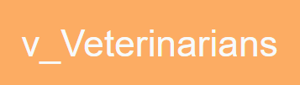
Vertex (State)
Contains all the assertions related to that state of the application
Notes:
State’ler uygulamanın herhangi bir zamanda bulunabiliceği stabil durum. Bu adımda bütün testlerimizi gerçekleştiriyoruz ve bu adımda olduğumuzu doğruluyoruz.

Slide 17
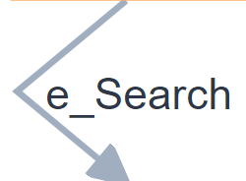
Edge (Action)
Contains the actions which will change the state of the program.
Clicking a button or navigating to a page
Notes:
Stateler arası geçişi sağlıyoruz. Herhangi bir test işlemi (assertion) yok.

Slide 18
PetClinic

Slide 19
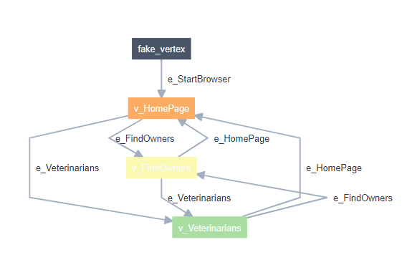
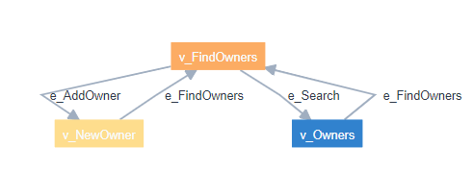
Model
Notes:
GraphWalker başlangıç nesnesinden başlayıp gidebileceği her rotaya gitmeye çalışıyor.

Slide 20
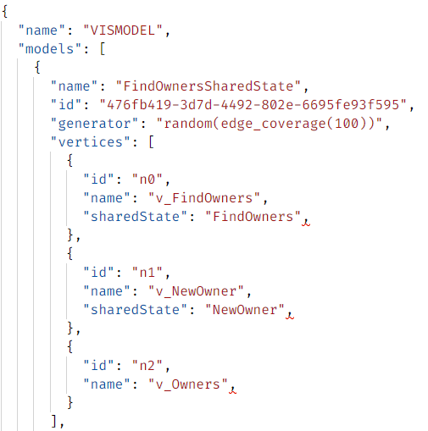
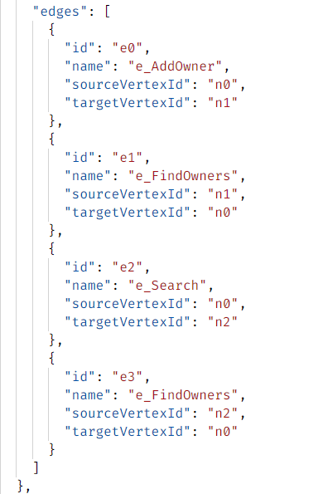
Model as a JSON file

Slide 21
How we use GraphWalker
load(model)
while(hasNext())
{
methodToCall = getNext()
method = findMethod(methodToCall)
method() // Binding
}

Slide 22
GraphWalker: a RESTful API
POST http://localhost:8887/graphwalker/load
GET http://localhost:8887/graphwalker/hasNext
GET http://localhost:8887/graphwalker/getNext

Slide 23
Demo
https://gitlab.piworks.net/ali.parlakci/mbt-demo

Slide 24
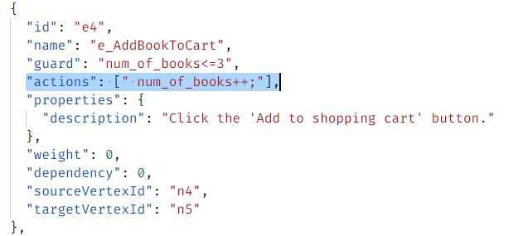
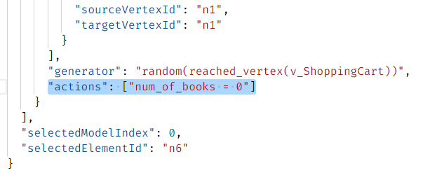
Data persistence during testing
PUT http://localhost:8887/graphwalker/setData/{script}
GET http://localhost:8887/graphwalker/getData

Slide 25
Generator Examples
random(edge_coverage(50))
random(reached_vertex(v_SomeVertex))
random(edge_coverage(100) or time_duration(500))
random(reached_vertex(v_SomeVertex) and edge_coverage(100)) random(time_duration(3600))

Slide 26
Generators
Stop conditions
random(some stop condition(s))
weighted_random(some stop condition(s))
quick_random(some stop condition(s))
a_star(a stop condition that names a vertex or an edge)
edge_coverage(an integer representing percentage of desired edge coverage)
vertex_coverage(an integer representing percentage of desired vertex coverage)
reached_vertex(the name of the vertex to reach)
reached_edge(the name of the edge to reach)
reached_edge(the name of the edge to reach)

Slide 27
The Truth about MBT

Slide 28
Tool | Modified | Input format | Type
4Test | 2018 | Custom (Gherkin based) | Commercial + Free version
BPM-X | 2018 | BPMN, UML... | Commercial
Conformiq Creator | 2018 | Activity Diagrams, DSL | Commercial
Conformiq Designer | 2016 | UML State Machines, QML | Commercial
fMBT | 2017 | Custom (AAL) | Open source
GraphWalker | 2018 | FSM | Open source
GSL | 2017 | Petri net | Commercial
JSXM | 2016 | EFSM (Stream X-machines) | Academic
MaTeLo | 2018 | Markov chains | Commercial
MBTsuite | 2018 | UML or BPMN | Commercial
Modbat | 2016 | EFSM (Scala-based DSL) | Open source
ModelJUnit | 2016 | EFSM | Open source
MoMuT::UML | 2018 | UML state machines, OOAS | Academic
OSMO | 2018 | model program in Java | Open source
RT-Tester | 2017 | UML/SysML, Matlab | Commercial
Smartesting CertifyIt | 2017 | UML / BPMN + OCL | Commercial
Smartesting Yest | 2018 | Workflow models with decision tables | Commercial
Tcases | 2018 | Custom | Open source
TestCast | 2018 | UML State Machines | Commercial
TestOptimal | 2017 | (E)FSM | Commercial
Tricentis Tosca | 2018 | Data model | Commercial
http://mit.bme.hu/~micskeiz/pages/modelbased_testing.html

Slide 29
Tools that are discontinued
AETG
Cow_Suite
DTM
GATeL
JTorX
JUMBL
MISTA
NModel
PyModel
SAL-ATG
SCOOTER
Spec Explorer
STG
TEMPPO
TGV
TorX
TTmodeler
T-VEC
UPPAAL Cover
UPPAAL TRON
AETG
…
…
…
http://mit.bme.hu/~micskeiz/pages/modelbased_testing.html

Slide 30
Why is not THAT popular?
Modelling an application is a unique skill and a unique responsibility.
Developing reliable, enterprise level tools are not cheap.
Constraint solvers are not that competent for test input generation, yet.

Slide 31
Behavior-driven Development

Slide 32
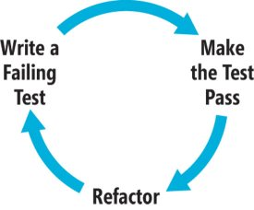
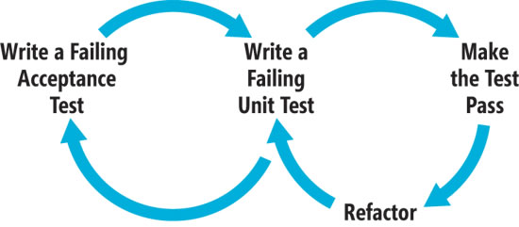
Test-driven development
Behavior-driven development
https://docs.microsoft.com/en-us/archive/msdn-magazine/2010/december/msdn-magazine-bdd-primer-behavior-driven-development-with-specflow-and-watin

Slide 33
Behavior-driven Development
is an agile development practice
Features are explained in a natural language (Turkish, English, etc.) as behaviors.
Test cases are derived from behaviors.
Behaviors are structured with Given/When/Then statements

Slide 34
SpecFlow for .NET
Testing tool for implementing behavior-driven development
Able to work with number of different testing frameworks such as MSUnit, NUnit, XUnit, including its own framework SpecFlow Runner+
Is used to bind Given/When/Then statements to methods.

Slide 35
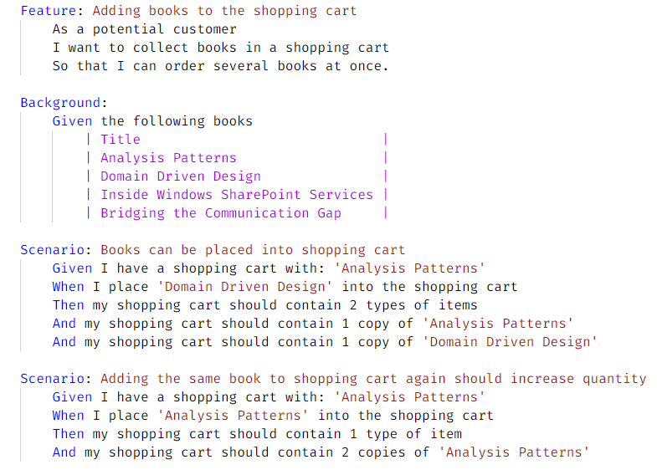
Features
in a natural language

Slide 36
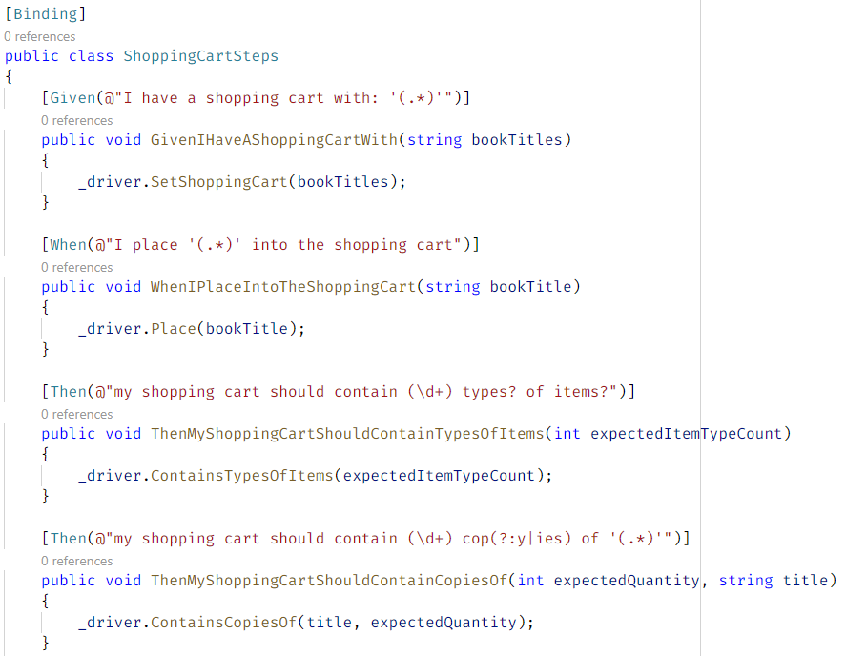
Bindings
in a formal language (C#)

Slide 37
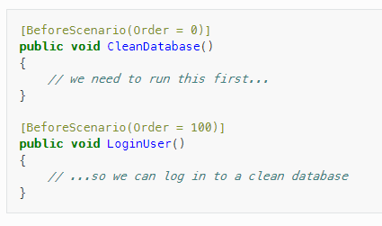
Hooks

Slide 38
Hooks
[BeforeTestRun] / [AfterTestRun]
[BeforeFeature] / [AfterFeature]
[BeforeScenario] / [AfterScenario]
[BeforeScenarioBlock] / [AfterScenarioBlock]
[BeforeStep] / [AfterStep]

Slide 39
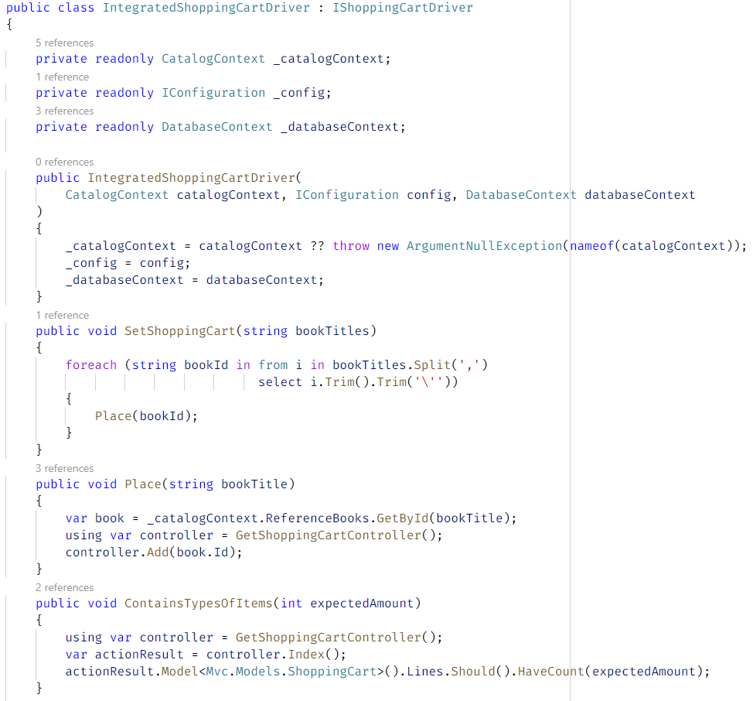
Drivers

Slide 40
Demo
https://gitlab.piworks.net/ali.parlakci/specflow-demonstration

